Slide 1
Enhanced Involvement of Women In Geotechnical Practice

Slide 2
DFI Women in Deep Foundations (WiDF) Committee: Established in 2014

Slide 3
WiDF Mission
To enhance professional opportunities for women in the deep foundations industry.

Slide 4
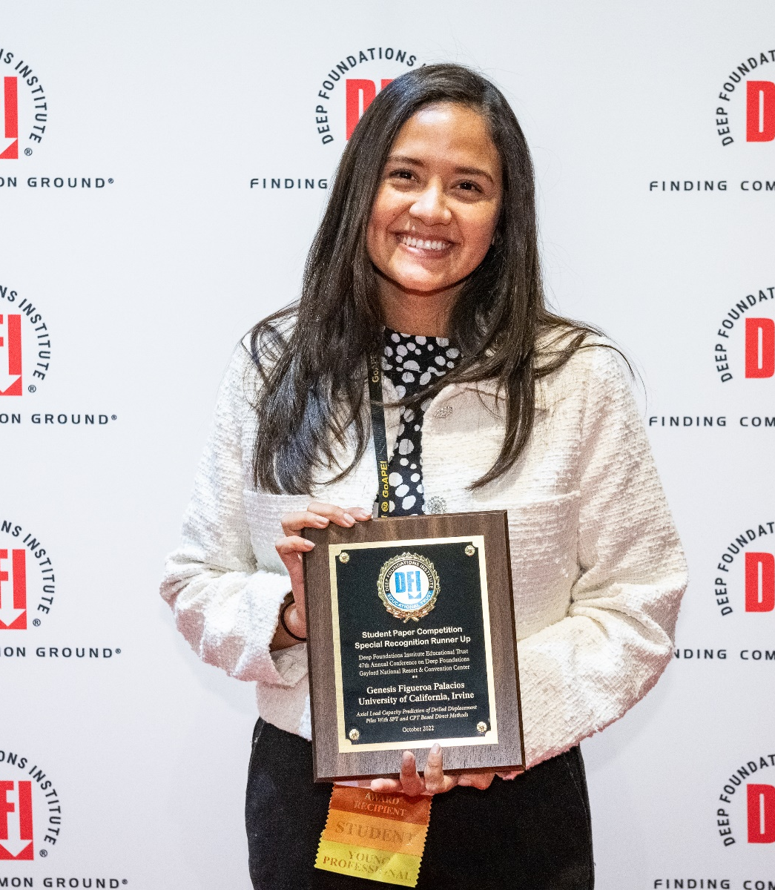
WiDF Goals
The WiDF program creates networking, mentoring and professional development programs that support career readiness and raise awareness of career opportunities in geotechnical engineering and deep foundations design and construction.

Slide 5
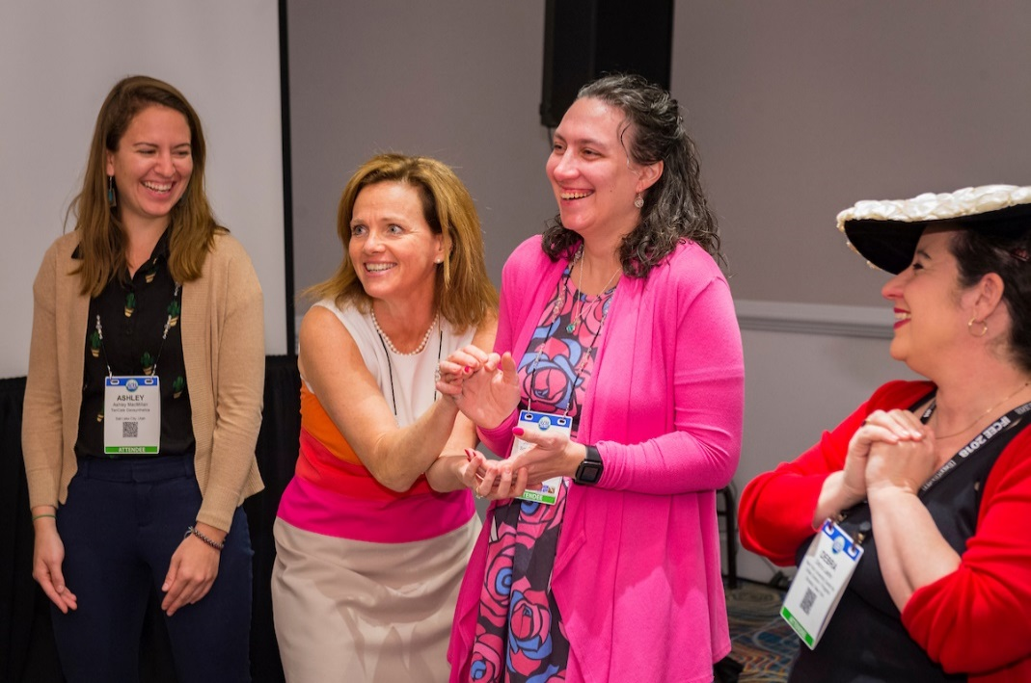
Professional Development Workshops

Slide 6
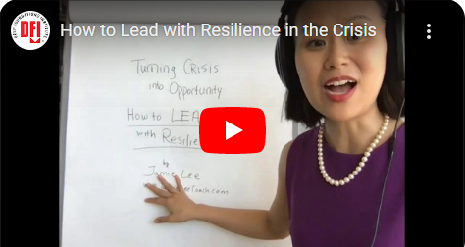
Webinars

Slide 7
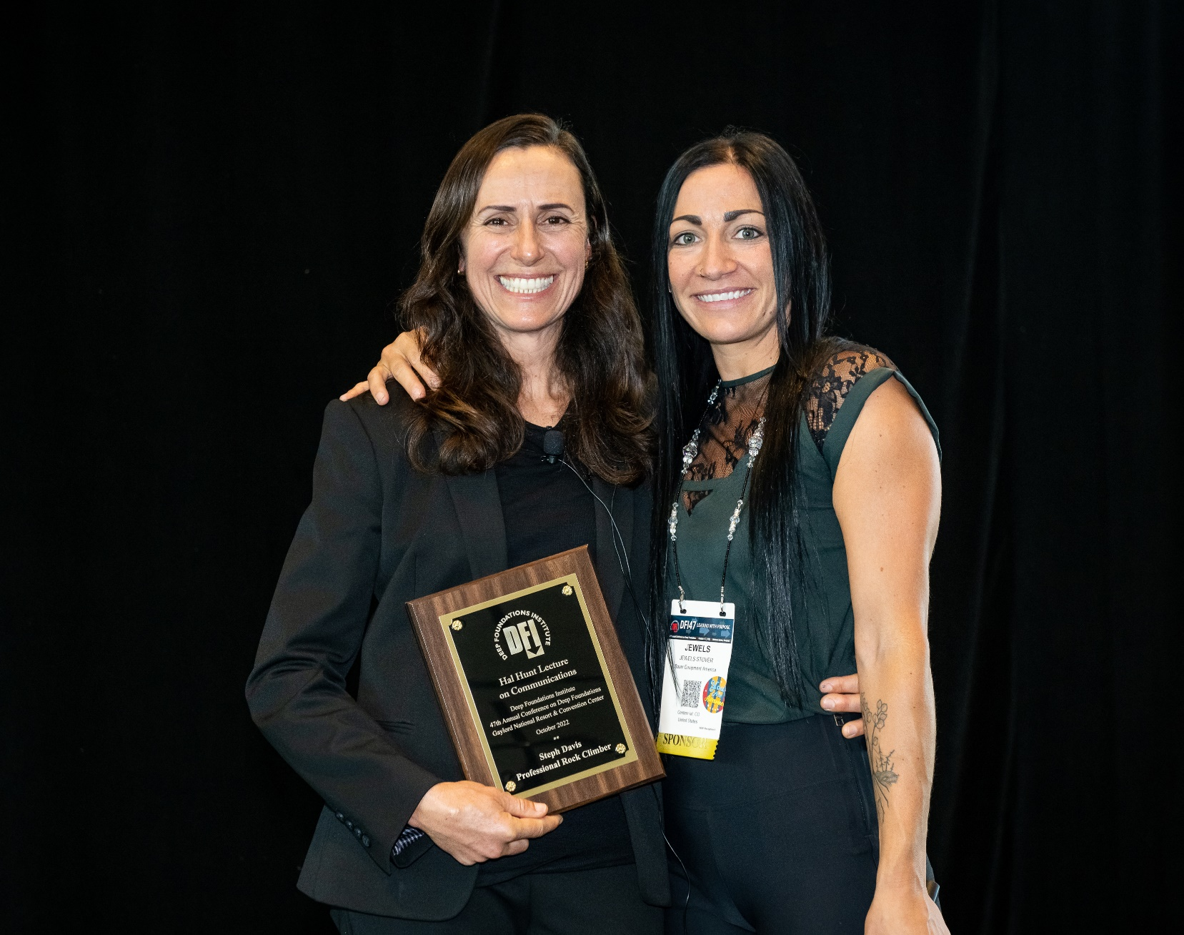
Lectures
2022 Hal Hunt Lecture on Communication featuring iconic climber Steph Davis

Slide 8
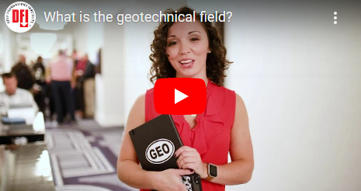
Outreach Video

Slide 9
Networking Receptions

Slide 10
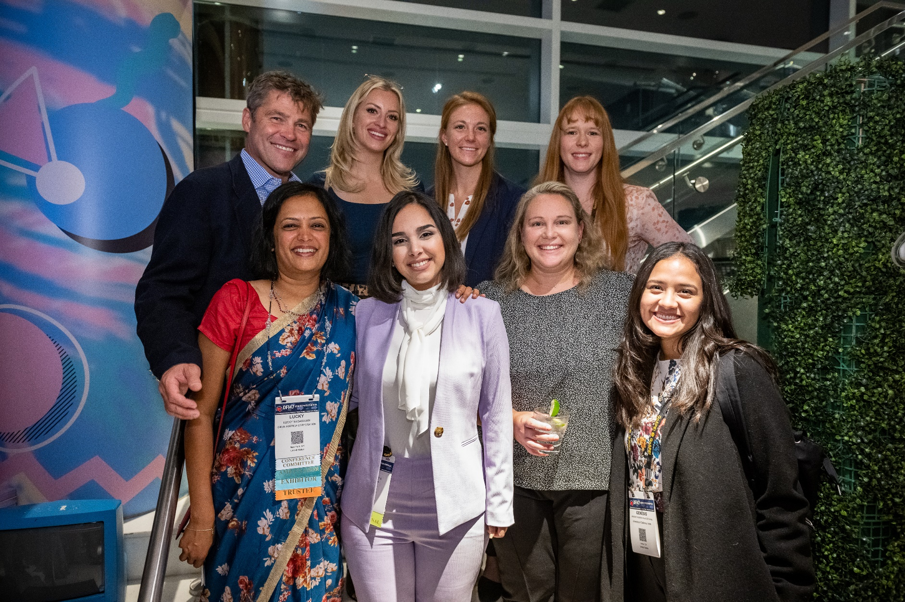
Professional Development Grants

Slide 11
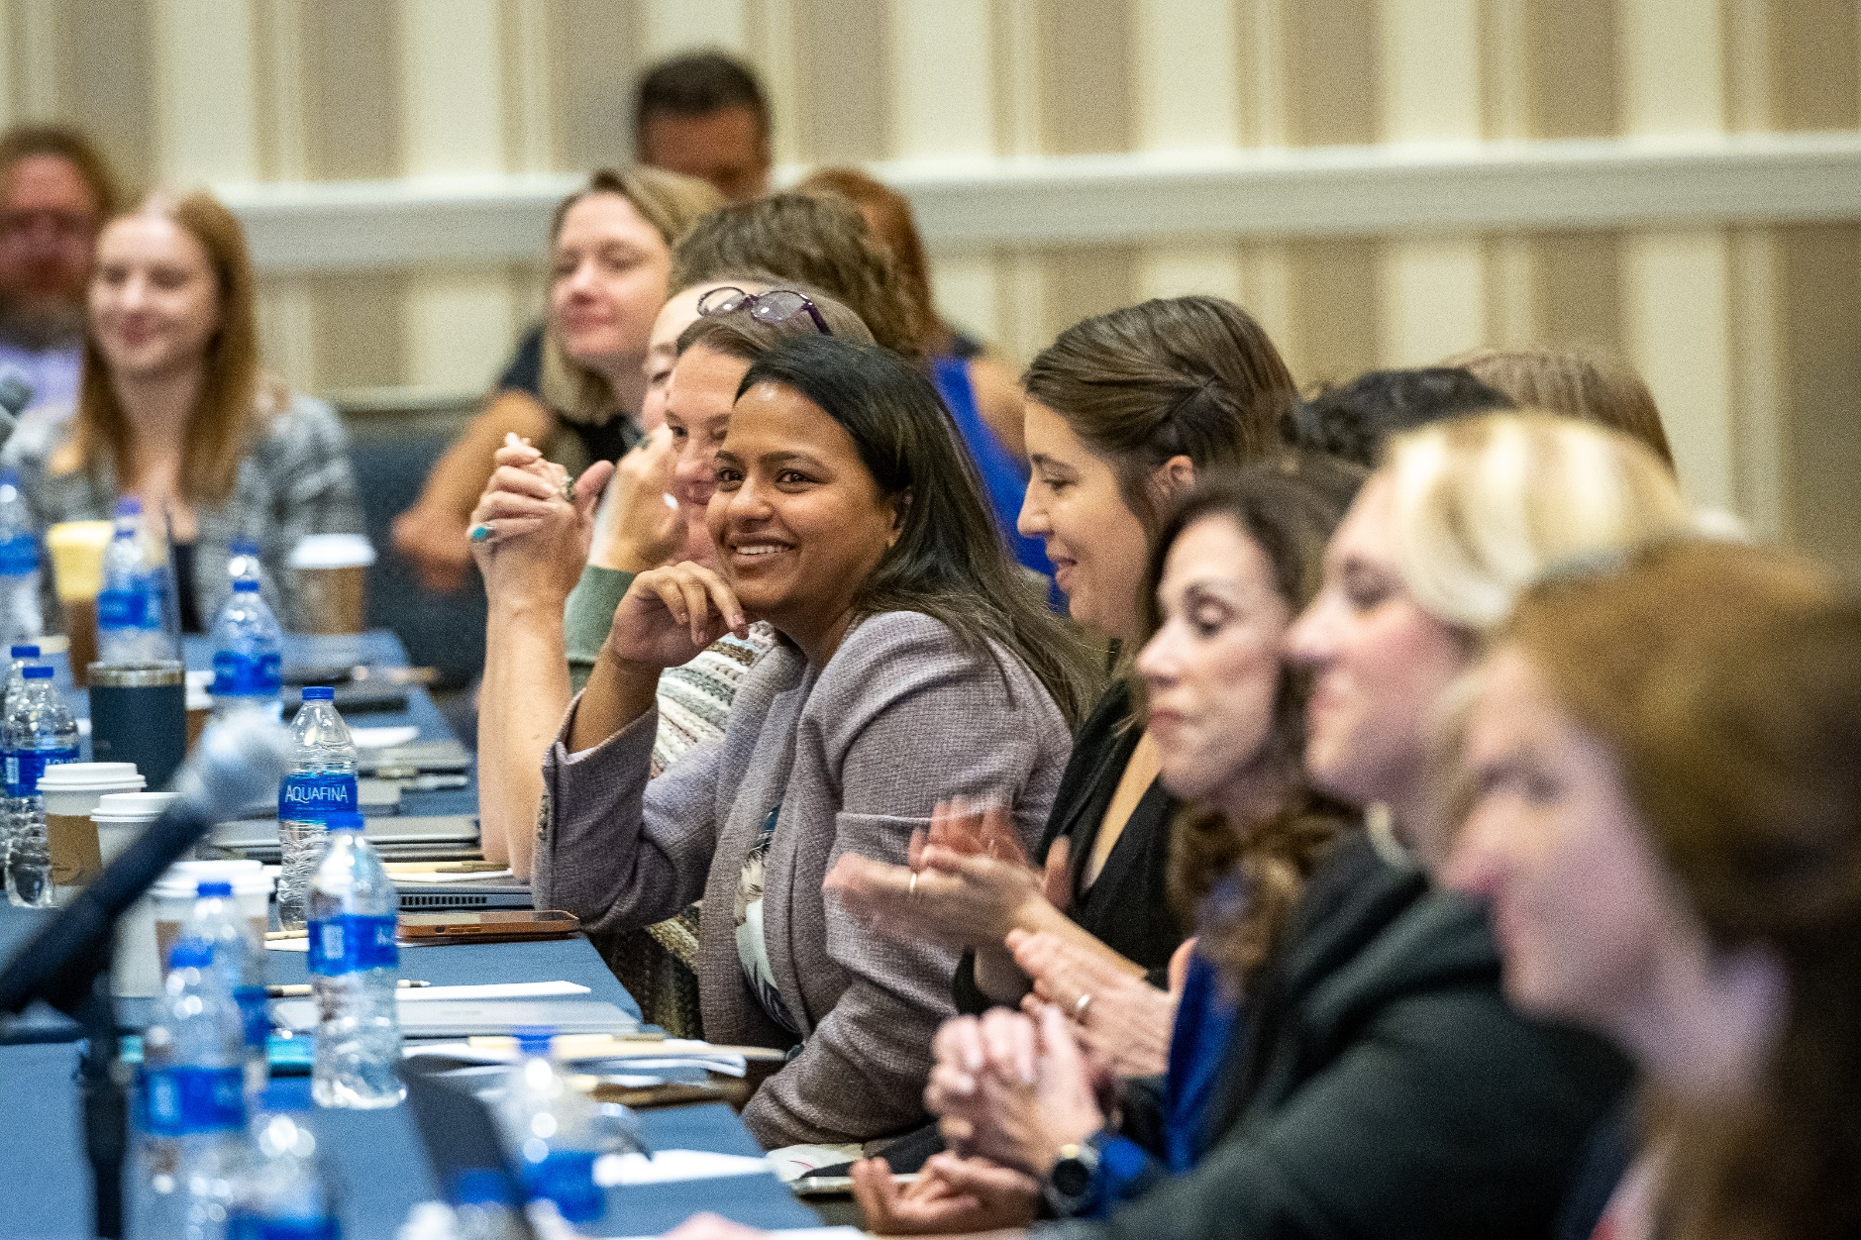
Committee Meetings

Slide 12
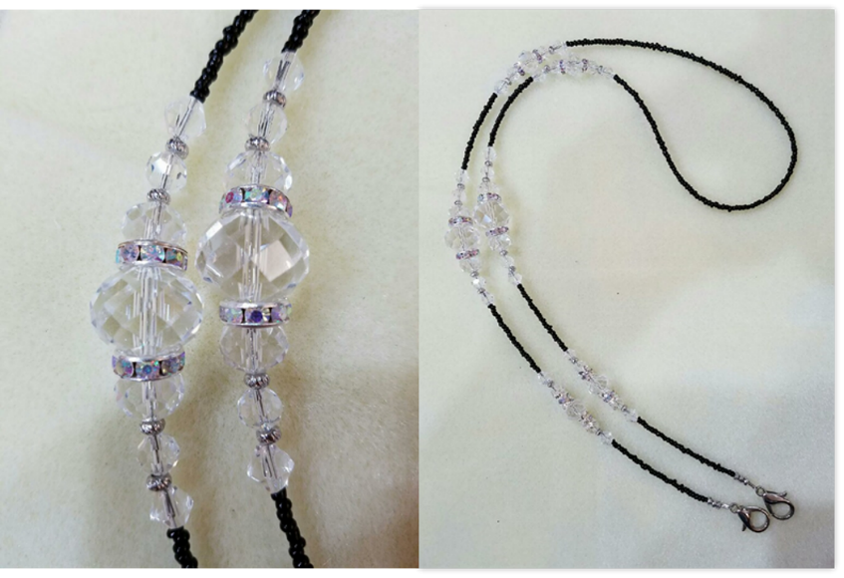
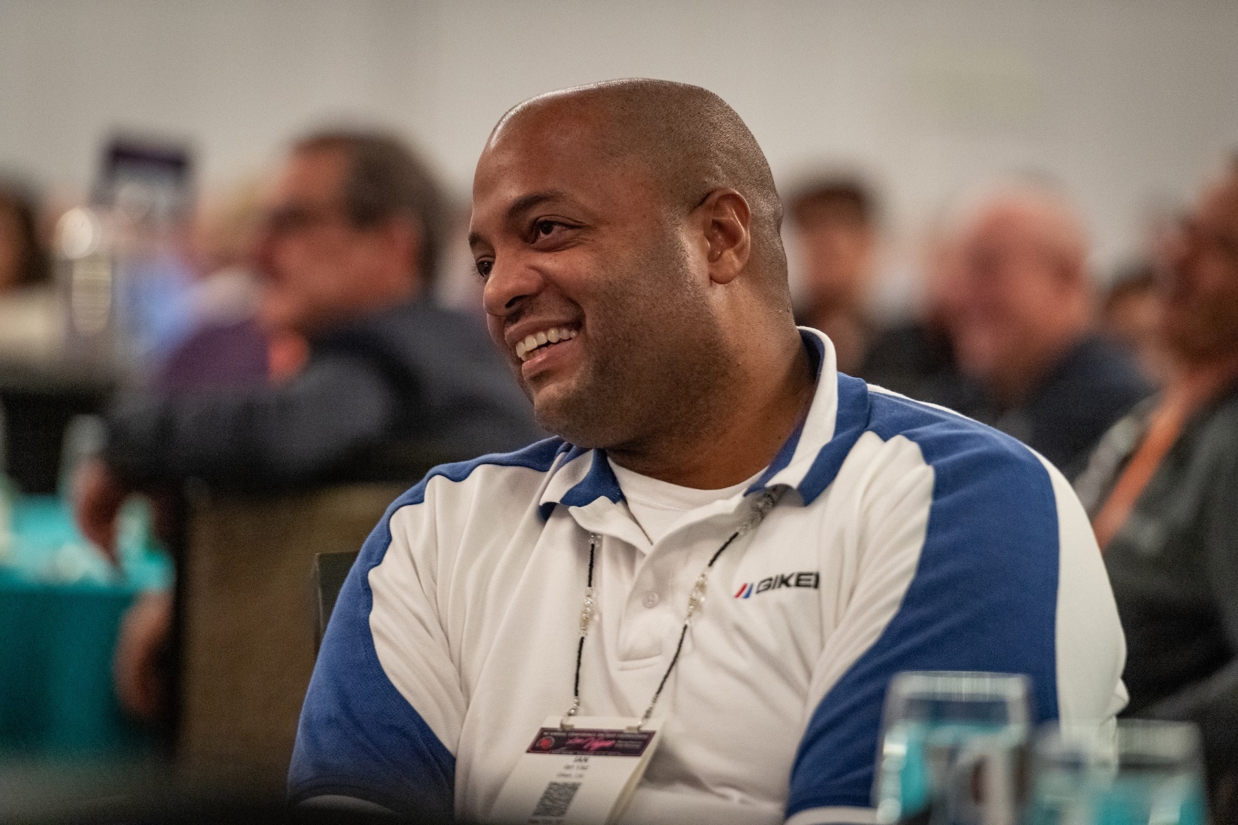
Lanyards

Slide 13
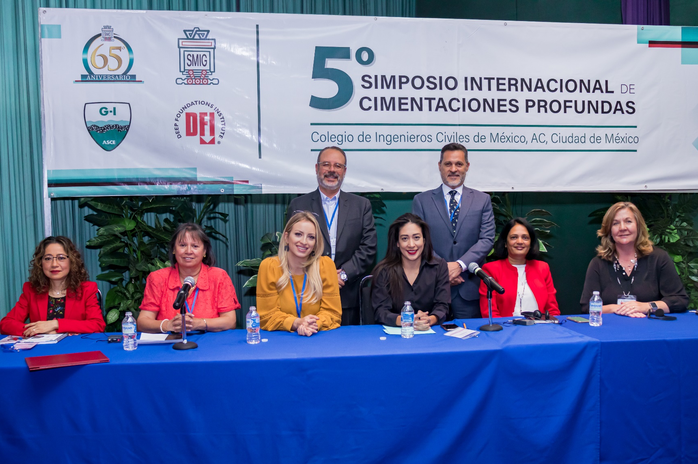
Regional WiDF Groups
Metro NYC WiDF Group
Pittsburgh WiDF Group
Mexico WiDF Group

Slide 14
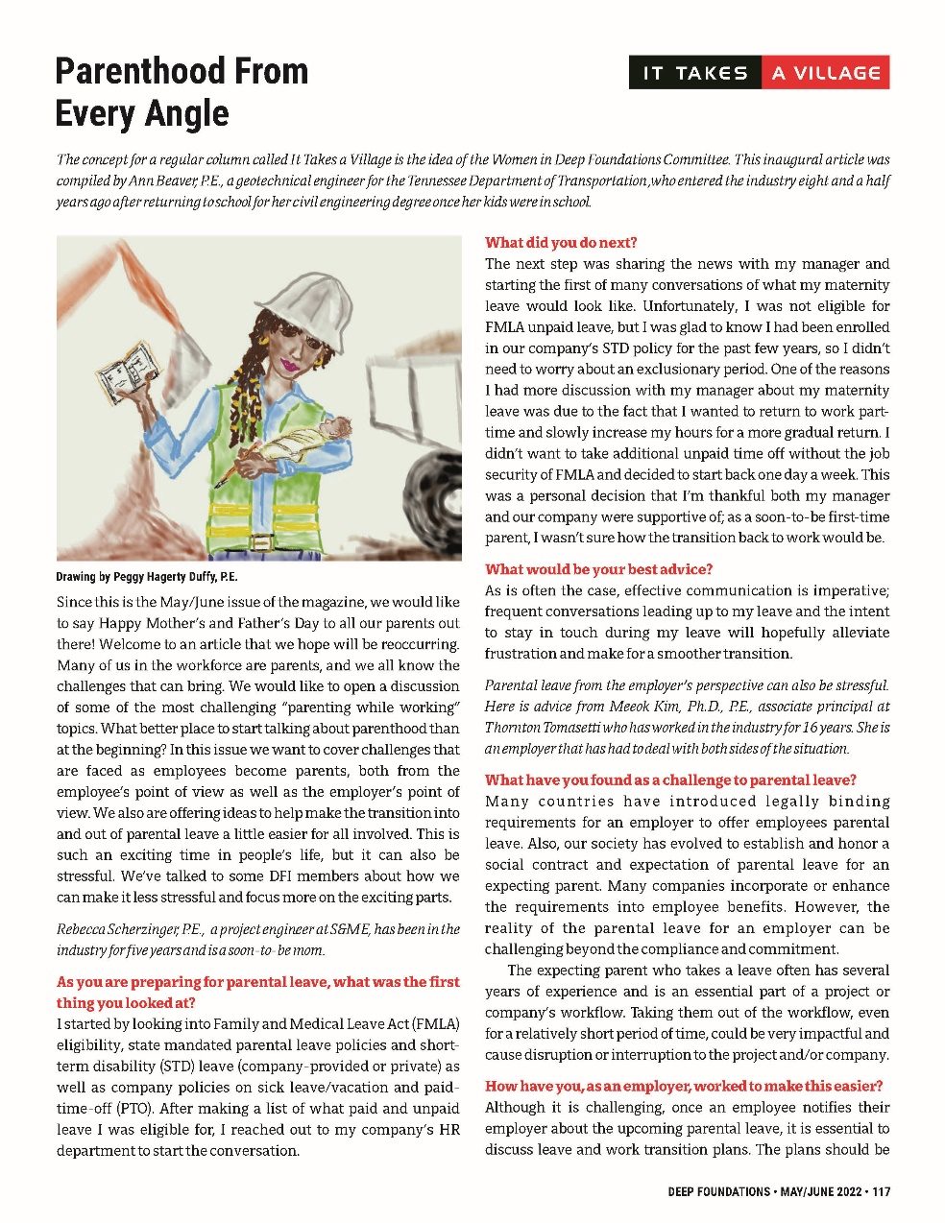
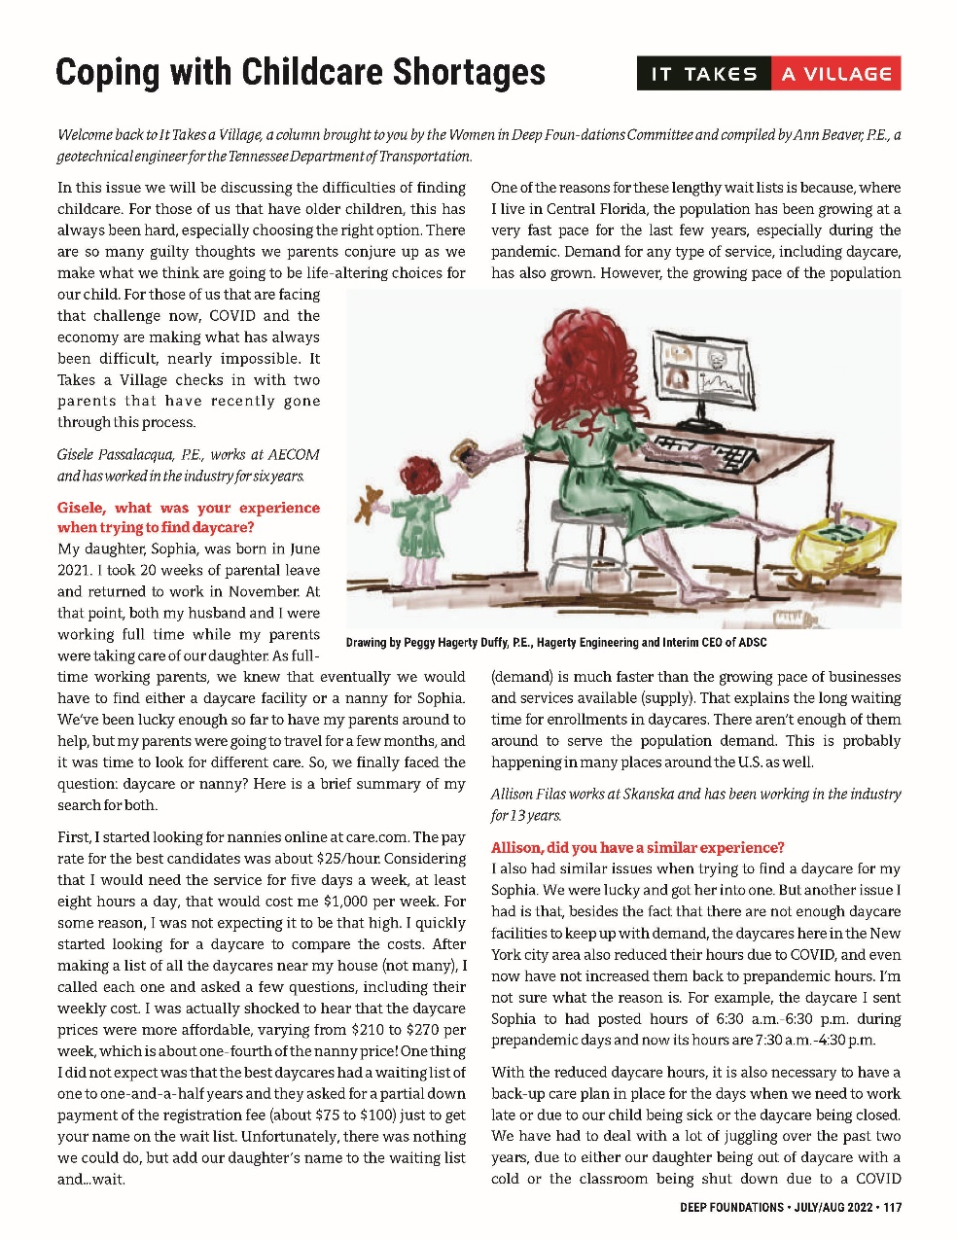
WiDF Parenting Column: It Takes a Village

Slide 15
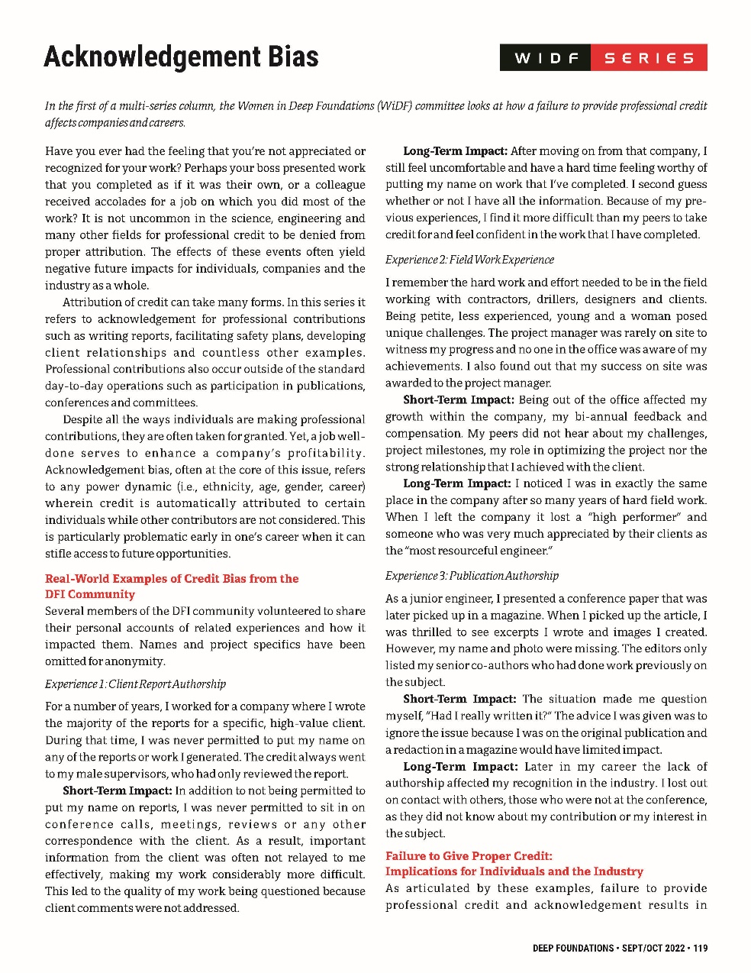
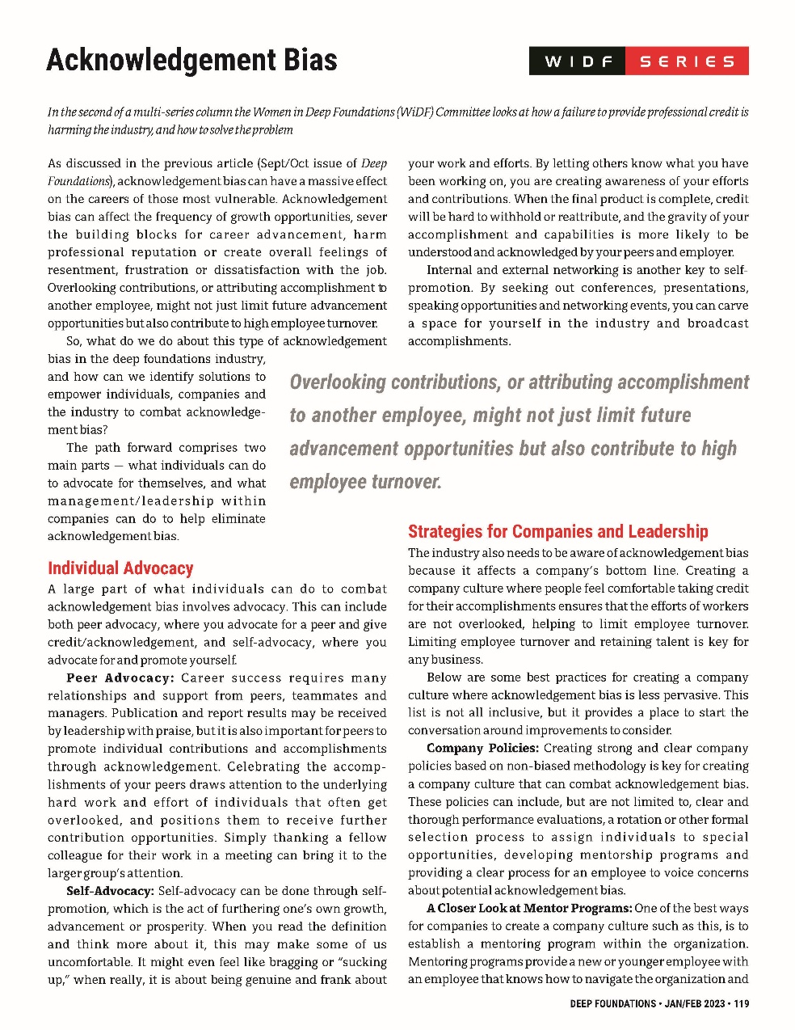
Acknowledgement Bias Survey and Column

Slide 16
% Conference Attendees - Female

Slide 17
# Female Authors and Speakers

Slide 18
% Female Technical Committee Positions
136
11 times
12

Slide 19
DFI Member Companies Women’s Groups

Slide 20
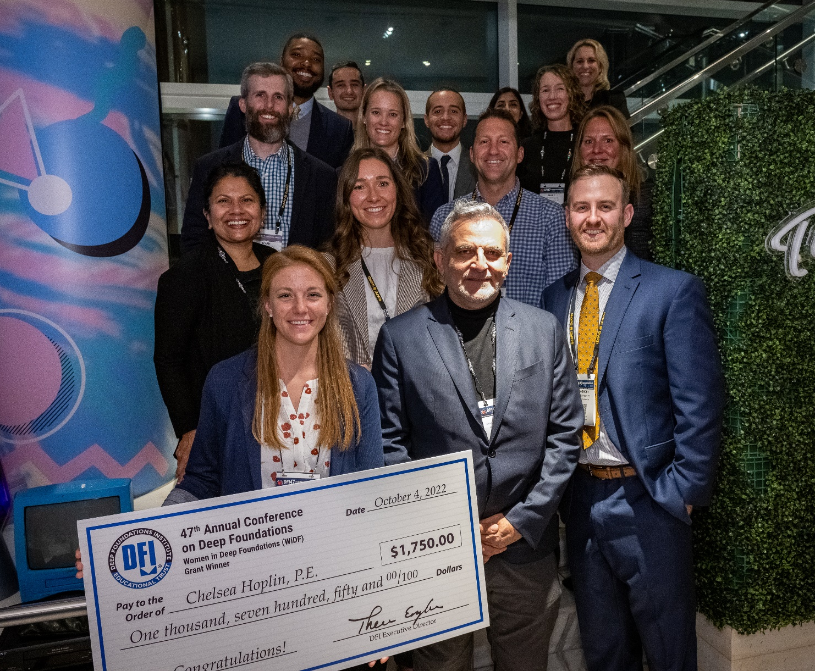
Key to WiDF Success
The Combined Efforts of Both Women AND MEN!

Slide 21
Key to WiDF Success: Positive Messaging
It’s not about calling anyone OUT
It’s about calling everyone IN

